Slide 1

California Climate Disclosure Preparation
TFI WEBINAR
Amanda Mast, Director
Wilson Fong, Manager
Notes:
Thank you, Alice, for inviting us to speak.
we’ll covering some best practices we’re seeing on California climate disclosures as companies are getting ready for 2026 deadlines.

Slide 2







Sustainability Advisory
Climate Risk Assessments & Reporting
Regulatory Optimization
GHG Accounting & Life Cycle Assessment
Decarbonization Strategy
Impact Reporting
Green Premium Valuation & Verification
Our Mission
Carbon Management
Origination & Due Diligence
Methodology Review & Development
Deal Structuring & Financing
Project Management & Reporting
Portfolio Hedging & Offtake Agreements
To advance the low-carbon future and restore nature with market-based solutions.
We provide comprehensive sustainability solutions to help clients maximize their environmental assets, minimize regulatory costs, and enhance their impact.
Environmental Credits
High Quality Carbon Credits
  Technology- & Nature-based Projects
Commodity Certificates
  Renewable Energy, Fuels, & Materials
Digital Carbon Solutions & Marketing
  EcoCommitted Labels
Notes:
Before jumping in, I’d like to share a little about who we are.
ClimeCo is a global sustainability company, with a focus on climate.
The company initially worked with industrial manufacturers, so we have a strong focus on industry, but we’re proud to have grown to support consumer facing brands.
Since our founding 15 years ago, we have reduced, avoided or removed more than 40 millions tonnes of carbon equivalents, impact we’re proud of and also a revenue driver for our clients.
I work in the Sustainability Advisory arm of the company, where we get to help clients meet customer, investor, or regulatory sustainability mandates. – including California.
I’m grateful to be joined today by my colleague, Wilson Fong who will run us through the agenda

Slide 3
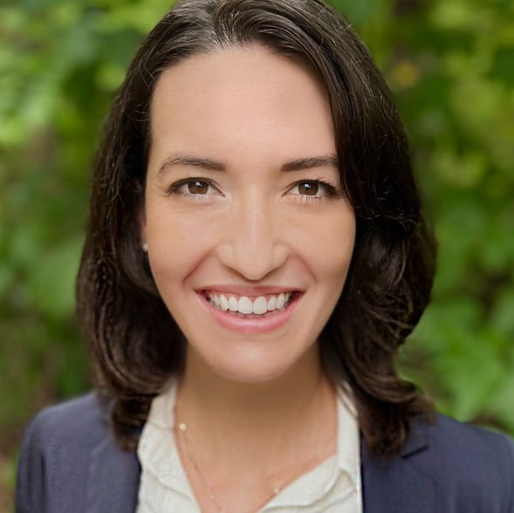



Speakers & Agenda
Amanda Mast
Director, Sustainability Advisory
SB 261 and SB 253 Overview
10+ years in corporate sustainability strategy, with a focus on climate risk and resilience
Frequently Asked Questions
Looking Ahead
Wilson Fong
Manager, Sustainability Advisory
6+ years in sustainability reporting, compliance, regulatory mapping, and policy impact analysis
Notes:
We heard that California requirements were of interest to TFI members so today we’ll
1) Cover a brief overview of requirements.
2) Share tips from early adopters through FAQ, to ease preparations
3) And look ahead at what’s emerging in the policy landscape, as California is not the only jurisdiction considering and implementing this type of legislation
4) And as time allows, we’ll field question at the end)
Handing it back to Amanda to run us through these requirements.
Our focus right now is helping our partners efficiently comply with California disclosures on emissions and risk. But we’re also seeing a lot of firms take away other benefits gain a better understanding of their emissions and risks to build more resilient businesses.

Slide 4


SB 261 and SB 253 Overview
Notes:
Thanks wilson

Slide 5
Deadlines Under California Climate Requirements - Senate Bills 253, 261, 219
New California legislation establishes climate disclosure requirements for firms, with deadlines approaching in 2026. Climate risk requirements impact U.S. public and private companies “doing business in California” with annual worldwide revenues exceeding $500M, with additional emissions disclosures at $1B.
SB 253 – California Corporate Greenhouse Gas Reporting Program
SB 261 – Climate-related Financial Risk Disclosure Program
DETAILS
Applies to public or private companies “doing business in California” with revenues exceeding the threshold
Penalties for noncompliance range from $50,000 to $500,000
Disclosures include greenhouse gas emissions footprints and climate risks
The California Air Resources Board is targeting the end of 2025 for regulation but has provided initial guidance, including checklists and templates
IMPLEMENTATION TIMELINE
Preparations needed for:
Emissions footprinting
Climate risk assessments
Risk report development
2026
Scope 1 & 2 emissions
Limited assurance
Scope 3 emissions initial reporting
2030
On or before January 1, 2026, and biennially thereafter, companies must prepare and publish a climate-related financial risk report
Ahead of June 2026 (proposed deadline), and annually thereafter, Scope 1 & 2 emissions must be inventoried and submitted to the emissions reporting organization; limited assurance is required initially
Scope 1 & 2 emissions
Reasonable assurance
Scope 3 emissions
Limited assurance (Pending)
2025
2027
5
Notes:
As a refresher:
First, these bill apply to BOTH Public and private companies “doing business in California” with revenues exceeding the thresholds $500M for climate risks $1B for emissions disclosures
California Air Resources Board (CARB) has released a draft list of covered entities, which is a helpful place to start to see if you may be subject to these requirements
What’s significant about the programs created by this legislation is the breadth of firms covered, including many private firms who have never reporting on sustainability topics
In addition to the breadth of coverage, the Penalties for non-compliance are also notable - range from $50,000-$500,000 per year;
At the same time, there are also reputational risks of sharing performance that lags behind peers.
CARB is targeting end of 2025 for regulation, but has provided initial guidance including checklists and templates
However, As you see on this timeline, deadlines start as soon as Jan 1 2026, so firms are moving forward without regulatory guidance.
The good news is that both bills align to existing standards, we do have a good sense of what compliant reports will look like

Slide 6
What Is Required for SB 261?
SB 261 requires firms to report climate-related financial risk in accordance with the framework of the Task Force on Climate-related Financial Risks, successor, or equivalent. CARB’s Draft Checklist aligns closely.
Pillar | Required Disclosures
A. Governance | 1. Describe the Board's oversight of climate-related risks and opportunities
 | 2. Describe management's role in assessing and managing climate-related risks and opportunities
B. Strategy | 3. Describe the climate-related risks and opportunities the organization has identified over the short, medium, and long term
 | 4. Describe the impact of climate-related risks and opportunities on the organization's businesses, strategy, and financial planning
 | 5. Describe the resilience of the organization's strategy, taking into consideration different climate-related scenarios, including a 2 °C or lower scenario
C. Risk Management | 6. Describe the organization's processes for identifying and assessing climate-related risks
 | 7. Describe the organization's processes for managing climate-related risks
 | 8. Describe how processes for identifying, assessing, and managing climate-related risks are integrated into the organization's overall risk management
D. Metrics & Targets | 9. Disclose the metrics used by the organization to assess climate-related risks and opportunities in line with its strategy and risk management process
 | 10. Disclose Scope 1, Scope 2, and, if appropriate, Scope 3 greenhouse gas (GHG) emissions, and the related risks
 | 11. Describe the targets used by the organization to manage climate-related risks and opportunities, and performance against targets
Notes:
First - For SB 261, a compliant report means one that aligns with guidance from the Task force on climate related financial disclosures (TCFD) or an equivalent framework.
The TCFD released their guidance back in 2017. Since then many firms have reported their climate risks voluntary., so there are public examples available to references
The framework covers 4 pillars –
Climate governance, strategy, risk management and metrics and targets.
CARB has also released a draft checklist firms can use in preparing reports which aligns very closely to TCFD.

Slide 7
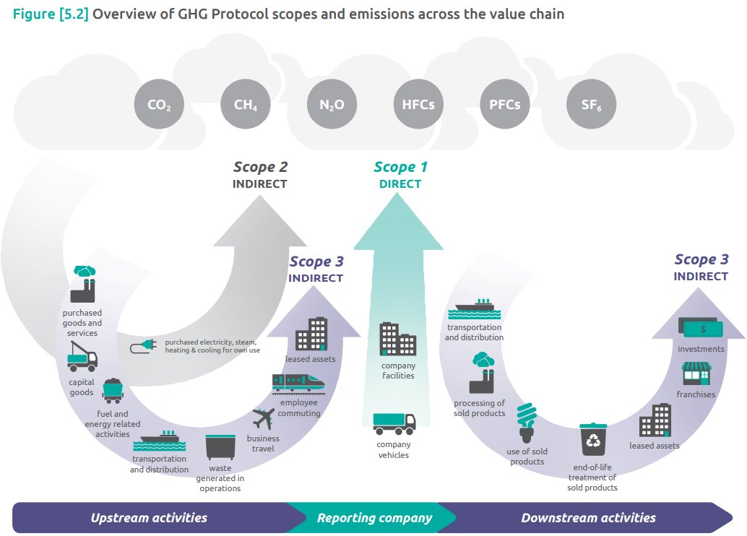
What Is Required for SB 253?
SB 253 requires firms to annually report Scope 1 & 2 emissions, and eventually Scope 3, pursuing varying degrees of assurance. CARB has released a draft template of the requested information.
Notes:
For SB 253,
Firms must report scope 1 & 2 emissions, direct emission and electricity/steam/heating based. The proposed deadlines is currently June 2026, and annually thereafter.
Luckily Scope 3 emissions are not required in the initial reporting year. Firms have until 2027 to capture those additional upstream and downstream emissions.
And for all emissions, third–party verification is required
Fortunately, the bill itself asks companies to align the Greenhouse Gas Protocol which is the leading voluntary reporting standard, so practitioners do have a good sense of what a compliant footprint should look like

Slide 8
Our Roadmap for SB 261 Compliance
SB 261 Readiness Assessment
Evaluate current disclosures and governance processes against CARB and TCFD 2017 requirements to identify key gaps and priority actions for compliance.
1
Climate Risks & Opportunities Assessment
Identify and prioritize material transition and physical risks using client data, peer benchmarks, and interviews — aligning results to TCFD categories.
2
Scenario Analysis
Assess business resilience under multiple climate scenarios, evaluating potential financial and operational impacts in both low- and high-emission futures.
3
Climate Risk Report (Y2025)
Develop a TCFD-aligned report that integrates assessment findings and scenario insights, ready for disclosure under California SB 261.
4
Future
SB 253 Readiness and Compliance (Y2026)
Conduct GHG foot printing exercise with verification
5
Notes:
There is a lot to prepare for both bills, so we recommend a few steps to focus efforts
A readiness assessment – to inventory internal and external documentation globally to leverage as much existing work as possible;
our clients are often surprised by how much their existing governance and risk management practices count for California.
The next step is to thoroughly assess climate risks and opportunities, evaluating the company’s resilience under different future scenarios – through a scenario analysis (latter is recommended not required by CARB in year 1)
SB 261 prep finish with drafting a compliant risk report ahead of the January deadline
And for SB 253 coming a little later in 2026, companies need to develop that GHG footprint with verification
Its not a small amount of work in the first year, but if you set up the right processes, it can save a ton of time and headaches in future years.
Now I’m going to hand it back to Wilson to help with FAQs

Slide 9

Frequently Asked Questions
Notes:
Amanda: ask for Wilson’s help for the upcoming slides.
Wilson: While we have the expert on the line, next we’d like to highlights some frequently asked questions we’ve heard from our clients,
with some best practices from those who are moving quickly to prepare for CA

Slide 10
What Are the Minimum Requirements?
Climate risk management and emissions accounting is a journey over time. Guidance shared to-date indicates some leniency for companies who are putting in a “good faith effort” to comply with requirements. Collaboration with legal teams to determine risk tolerance is key.
The Climate Corporate Data Accountability Act – Enforcement Notice
CARB will exercise enforcement discretion for the first reporting cycle, on the condition that entities demonstrate good faith efforts to comply with the requirements of the law. This enforcement discretion is aimed at supporting entities actively working toward full compliance.
FAQs Regarding California Climate Disclosure Requirements
As outlined in Health and Safety Code § 38533, potential penalties against entities for violations are tied to several factors, including whether the violator took good faith measures to comply and when those measures were taken. This “good faith” consideration is part of CARB’s enforcement discretion in considering penalties for reporting violations.
Senate Bill No. 219
(B) If a covered entity does not complete a report consistent with all required disclosures pursuant to clause (i) of subparagraph (A), the covered entity shall provide the recommended disclosures to the best of its ability, provide a detailed explanation for any reporting gaps, and describe steps the covered entity will take to prepare complete disclosures.
Sources:
CARB Enforcement Notice
CARB "FAQs Regarding California Climate Disclosure Requirements“
California Senate Bill 219
Notes:
Wilson: For the firms who are reporting risks or emissions for the first time, the requirements can be daunting. What is the minimum we have to do in year 1?
Amanda:
Fortunately for many firms who are new to these disclosures, CARB has already made statements that they will “exercise their enforcement discretion for companies that show a “good faith effort” to comply with the law.
I always recommend clients discuss with their legal teams, what “good faith” could mean for them; However, these statements from CARB indicate some flexibility for firms in year 1
and some acknowledgement that good risks management, good emissions accounting takes time to build.

Slide 11
How Can I Coordinate Global Reporting Efforts?
Many of our partners are working across jurisdictions internationally, preparing for CSRD in Europe, Australian Sustainability Reporting Standards, or the UK’s Sustainability Reporting Standards. A few best practices have helped them align teams quickly and find efficiencies in global efforts – saving time and money in the medium-term.
Tip 1
Inventory existing disclosures and internal documents globally
Tip 2
Socialize preparations with Leadership, Risk, Legal, & Reporting
Tip 3
Establish review committee of core contacts
Tip 4
Disseminate results for use in other global reporting efforts, saving time
Proprietary & Confidential: Not for Distribution.
Notes:
Wilson: A lot of our partners represent the north American branches of global organizations with operations in Europe and Asia. They often ask us for help navigating and aligning global disclosures when this is just one of many reports required? I am seeing overlap, How can we harmonize these requirements?
Amanda:
these companies can save money and effort on disclosure, bc there is a lot of overlap across standards.
Some of these firms had a head start from content developed for CSRD which we could use and build on,
Through gathering information globally our Point of contact were able to identify helpful partners across different functions from risks management, legal, and marketing or comms.
We helped engage those partners throughout the reporting process, educating them on requirements and approach.
Because, we’d engaged them early, and create alignment, we’ve been able to simplify report reviews and avoid last-minute surprises
Coordinating a global committee even for California requirements is a best practices – so you can leverage and align global reporting efforts

Slide 12
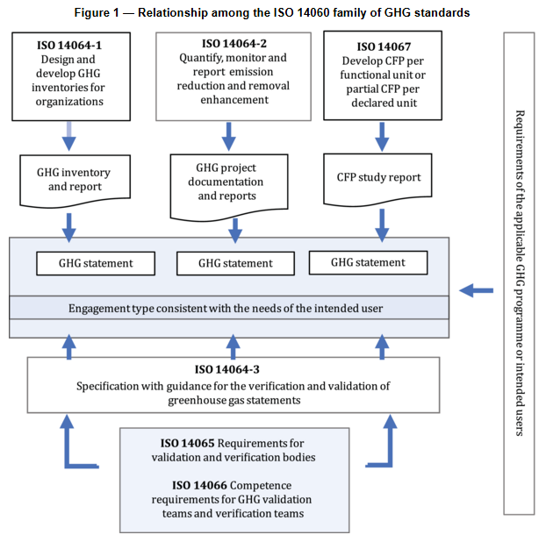


How Can I Be Sure My Footprint Is Ready for Verification?
Finding a CARB-approved verifier and running a pilot verification process now can significantly lower compliance risk ahead of 2026. At a minimum, prep an Inventory Management Plan.
ISO 14060 Family Represents One of the Standards Being Considered in CARB’s Staff Concept for Assurance
Limited Assurance
Reasonable Assurance
2026 for Scope 1 & 2
Limited review of data/controls
Less evidence gathering
Lower confidence in completeness and accuracy
2030 for Scope 1 & 2
Additional review of data/controls
More significant evidence gathering
Higher confidence in completeness and accuracy
Sources:
CARB Public Meeting
SCS Global “Preparing for the New Greenhouse Gas Inventory Verification Regulations”
Notes:
Wilson: Even for our clients who’ve been pursuing footprinting for a while, the verification portion of the requirements can seem daunting. What’s the best way to ensure a footprint is ready for verification?
Amanda: Run a pilot. There’s so much variation depending on the assurance provider – whether they are an accounting firm or an environmental consulting firm. The clients I think are most prepared are ones who have already gone through the process at least once with their verification partner.
These are the ones who know the steps and that their data collection and results can stand up to scrutiny.
I’ll ask the last question:

Slide 13
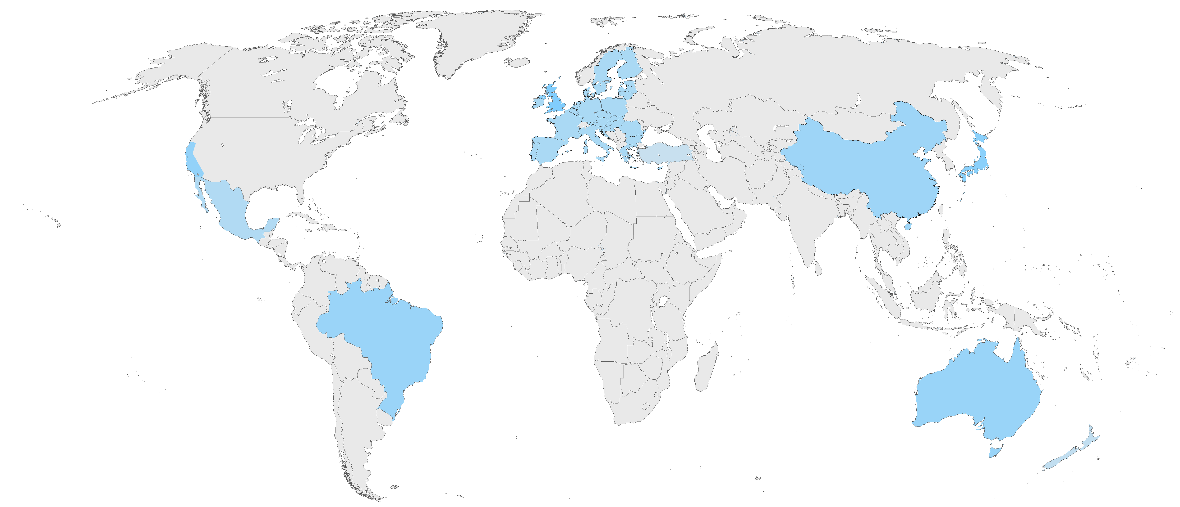
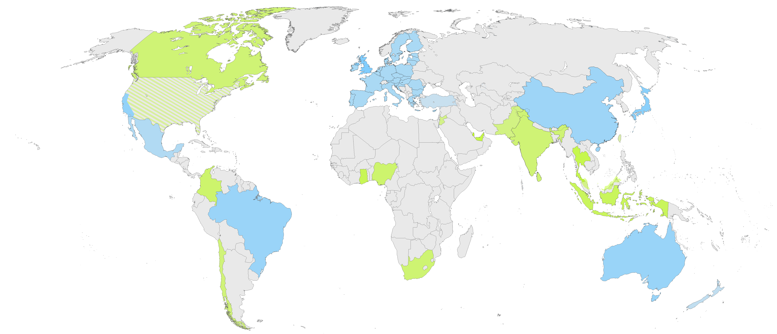
What’s on the Horizon?
Active _{(as of October 2025)}
Potential (In development, consideration, and/or planned)
~ 10 Jurisdictions with Mandated Climate-Related Disclosures
Linked to the size of the entity ($)
Operating location
Note: Does not include jurisdictions that mandate sustainability-related reporting and disclosures
(e.g., Bill C-59 Canada)
Notes:
Amanda: Some firms are facing California’s requirements with fewer preparations than they would have liked.
One of the questions we get asked often is what’s coming next so we don’t get surprised again?
Wilson: Existing mandates- flagging regions it may be helpful to coordinate with
Potential mandates to monitor going forward – (including various US states)
Across the world, we’re seeing real momentum. Ten jurisdictions highlighted in blue here already require some sort of climate-related disclosure, with thresholds often tied to the size of the company or its geographic footprint.
And this momentum is accelerating. The areas shown in green highlight places where new disclosure rules are in development or under consideration. To note, this map would be filled in even further had we considered sustainability-related disclosures broadly, Bill C-59 in Canada, for example. To wrap this up, there is a growing patchwork of pressure for climate disclosure, and regulatory expectations are broadly aligned and may pull you in based on your supply and value chains. Emphasizing the significance of this webinar and why we need to be on top of climate-related disclosures and ready for the next wave of change.
[End final point > with that I will hand it back to Amanda to provide some important questions we should all be asking ourselves]
California
SB 261
Australia
- https://www.finance.gov.au/government/climate-action-government-operations/commonwealth-climate-disclosure-requirements
UK
https://www.legislation.gov.uk/uksi/2022/31/contents/made?utm_source=chatgpt.com
Turkey
The amendment to Turkish Commercial Code No. 6102 (Article 88) that authorised the Public Oversight, Accounting and Auditing Standards Authority (KGK) to set the national sustainability reporting standards (TSRS).
Japan
https://www.ssb-j.jp/en/ssbj_standards/2025-0305.html?utm_source=chatgpt.com
New Zealand
- https://environment.govt.nz/what-government-is-doing/areas-of-work/climate-change/mandatory-climate-related-financial-disclosures/?utm_source=chatgpt.com
Singapore
https://www.lw.com/en/insights/sgx-regco-to-incorporate-ifrs-standards-into-mandatory-climate-reporting-rules?utm_source=chatgpt.com
https://www.sgx.com/sustainable-finance/sustainability-reporting?utm_source=chatgpt.com
Mexico
Official Gazette of the Federation (DOF): 28/01/2025
https://www.dof.gob.mx/nota_detalle.php?codigo=5747872&fecha=28/01/2025#gsc.tab=0
Annual
Brazil
CVM Resolution 193, 227 and 231/232
2025 limited assurance
2026 reasonable assurance
China (Partial Implementation)
Companies that operate on the three major indexes must disclose. Everyone else is voluntary
The Rule “ Guidelines No. 14 of Shanghai Stock Exchange for Self-Regulation of Listed Companies—Sustainability Report (Trial)“
- https://www.bse.cn/important_news/200020878.html
https://kjs.mof.gov.cn/zhengcefabu/202509/t20250912_3972190.htm
https://www.china-briefing.com/news/chinas-new-application-guide-for-esg-disclosure-standards-implications-for-businesses/
https://www.china-briefing.com/news/china-unveils-basic-standards-for-corporate-sustainability-esg-disclosure/
https://www.china-briefing.com/news/chinas-stock-exchanges-announce-esg-reporting-guidelines-for-listed-companies/#submissionofmandatoryesgreportsHeader
PLANNED/INTRODUCED/DISCUSSION
Canada (planned)
https://www.canada.ca/en/department-finance/news/2024/10/government-advances-made-in-canada-sustainable-investment-guidelines-and-mandatory-climate-disclosures-to-accelerate-progress-to-net-zero-emissions.html
India Planned
- ESG information - https://www.sebi.gov.in/legal/circulars/jul-2023/brsr-core-framework-for-assurance-and-esg-disclosures-for-value-chain_73854.html?utm_source=chatgpt.com
Climate-related information is RBI Climate Disclosure
Nigeria (pg 16, planned)
Financial Reporting Council of Nigeria Act, No. 6 of 2011 was amended to empower the council. The “Roadmap Report for Adoption of IFRS Sustainability Disclosure Standards in Nigeria” (April 2024) was released pursuant to those powers.
It sets the policy pathway for how Nigeria will domesticate IFRS S1/S2 into “Nigerian Sustainability Reporting Standards (NSRS)”, to be issued via an FRCN regulation or directive under the 2011 Act.
The regulation has yet to be created and gazetted
https://frcnigeria.gov.ng/2024/04/22/frc-releases-roadmap-report-for-adoption-of-ifrs-sustainability-disclosure-standards-in-nigeria/?utm_source=chatgpt.com
ROADMAP REPORT FOR ADOPTION OF IFRS SUSTAINABILITY DISCLOSURE STANDARDS IN NIGERIA (PDF) google search this
Thailand Planned
Climate Change Bill (Thailand) – in government draft/public consultation
Taiwan Planned
Regulatory advance notice by Financial Supervisory Commission Taiwan (FSC) to embed ISSB S2 for listed issuers (draft status)
South Africa Planned
Financial Sector Conduct Authority (South Africa) roadmap for mandatory climate-financial-risk disclosures (financial sector)
Columbia Planned
Superintendencia Financiera de Colombia – “Proyecto de Circular Externa 0402/2025” for enviro & climate risk disclosures under review
Indonesia Planned
Otoritas Jasa Keuangan (OJK) sustainability disclosure roadmap including IFRS S1/S2 alignment for financial & capital-market institutions
Qatar Planned
2025 Governance Code for listed companies references ISSB and introduces enhanced governance/disclosure expectations (step toward sustainability reporting framework).
UAE Planned
Regulators running consultations and guidance on sustainability-related disclosures and climate transition planning principles (federal supervisors’ SFWG principles under consultation).
Malaysia Planned
Bursa Malaysia Consultation Paper No. 1/2024 proposes Listing Rule changes to strengthen climate/ISSB-aligned reporting
Jordan Planned
Amman Stock Exchange has issued Sustainability & Climate disclosure guidance and touts market-level sustainability reporting—continuing enhancements signaled by ASE
Chile Planned
NCG 461
Amendments are currently underway

Slide 14

Can Reporting Insights Add Business Value?
1
Are you prepared for policy and regulatory shifts?
2
Are your operations resilient to key climate risks?
3
Is your leadership or Board informed of the risks and opportunities?
4
Can emissions reductions provide a climate opportunity?
Notes:
To close out our conversation today, we’d tie this work back to strategy.
While California’s bills are reporting exercise – all the information gathered is designed to provide some strategic insights:
1) It can help identify proposed policies to monitor/manage
2) Especially in the fertilizer industry, this information can show resilience of the business to changes in future weather, especially for risks emerging over the mid-term and long-term
3) reviewing/approving reports helps make sure company execs and Board been informed of the risks/Opps so you can get the resources needed to manage them effectively.
4) Public reporting from your customers will help indicate demand upstream for emissions reductions - that can make these a business opportunity for your firm?

Slide 15


CONTACT
Amanda Mast
  Director
  amast@climeco.com
Notes:
I hope this provided at least a few helpful teams. Every firms’ situation is different so please feel free to reach out and get connect. And best of luck with upcoming reports!
First question – you mention a lot of CARB resources, where can I find them?

Slide 16
Disclosure Roadmap Optimization & Implementation
Portfolio of solutions
ClimeCo can help clients prepare for complex new climate disclosure requirements in the EU, California, and Australia.
We focus on streamlining preparations globally to reduce the burden on client teams.
Our portfolio of solutions allows us to help companies at any stage in the process.
We train clients to build internal capacity rather than building reliance on software.
Portfolio of Disclosure Solutions
1. Identify Gaps
2. Create Roadmap
3. Enhance Governance
5. Measure & Reduce Impact
6. Disclose Performance
Streamline preparations across global requirements
4. Assess Risks & Opportunities
Index climate programs against disclosure requirements
Integrate climate into corporate practices
Inform strategy with top climate intelligence
Drive reductions to GHG footprint
Draft reports in alignment with requirements
Prioritize Gaps
Build Supporting Infrastructure
Get Credit for Results

Slide 17
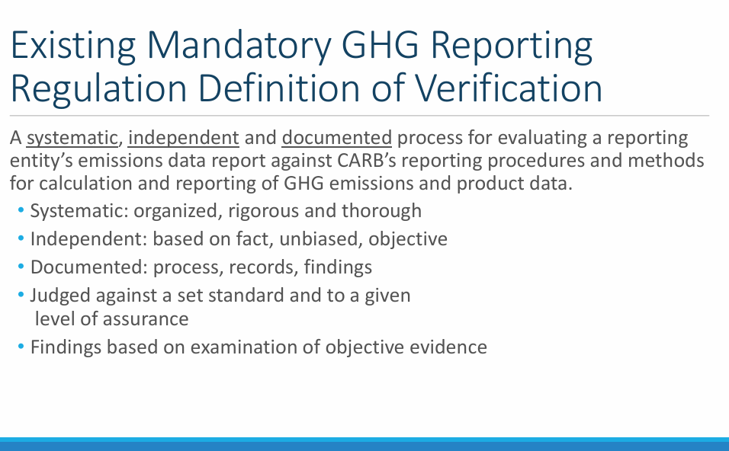
How Can I be Sure My Footprint is Ready for Verification?
Finding a CARB-approved verifier and running a pilot verification process now can significantly lower compliance risk ahead of 2026. At a minimum, prep an Inventory Management Plan.
Limited Assurance
Reasonable Assurance
2026 for Scope 1 & 2
Limited review of data/controls
Less evidence gathering
Lower confidence in completeness and accuracy
2030 for Scope 1 & 2
Additional review of data/controls
More significant evidence gathering
Higher confidence in completeness and accuracy
Sources:
CARB Public Meeting
SCS Global “Preparing for the New Greenhouse Gas Inventory Verification Regulations”

