Slide 1
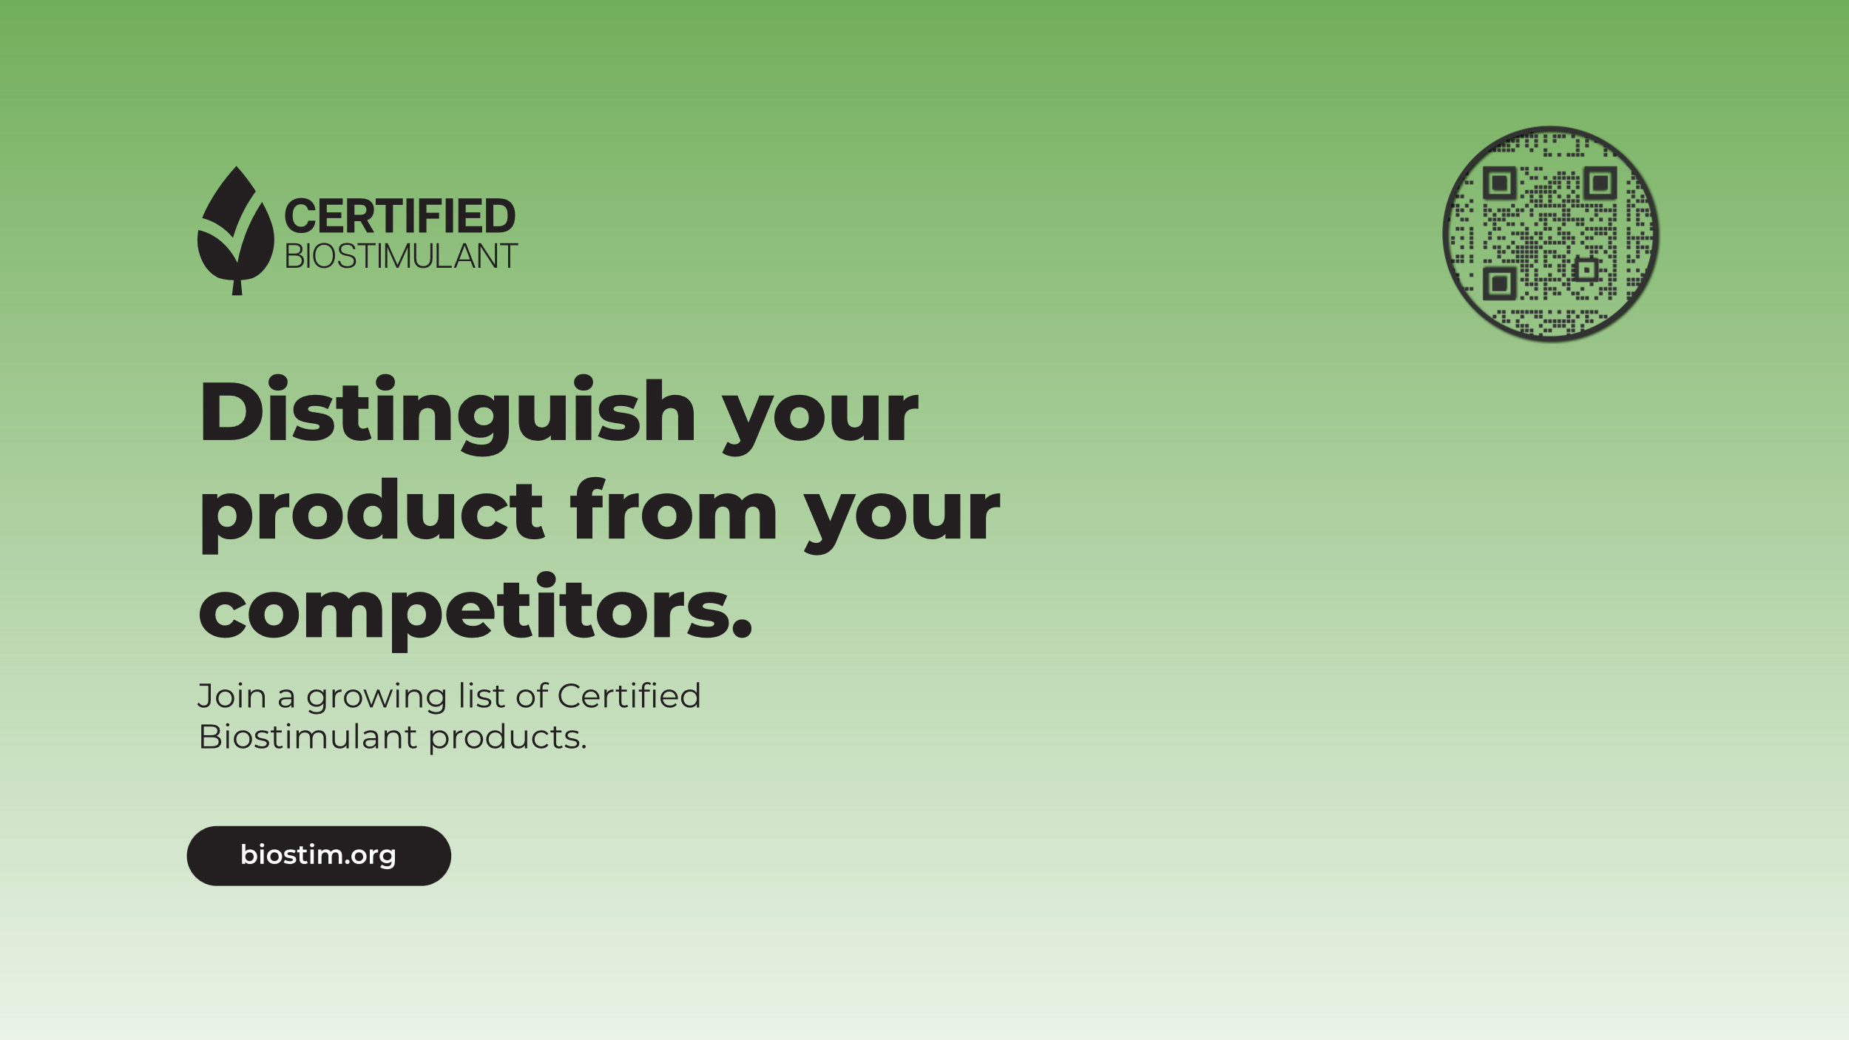

Slide 2
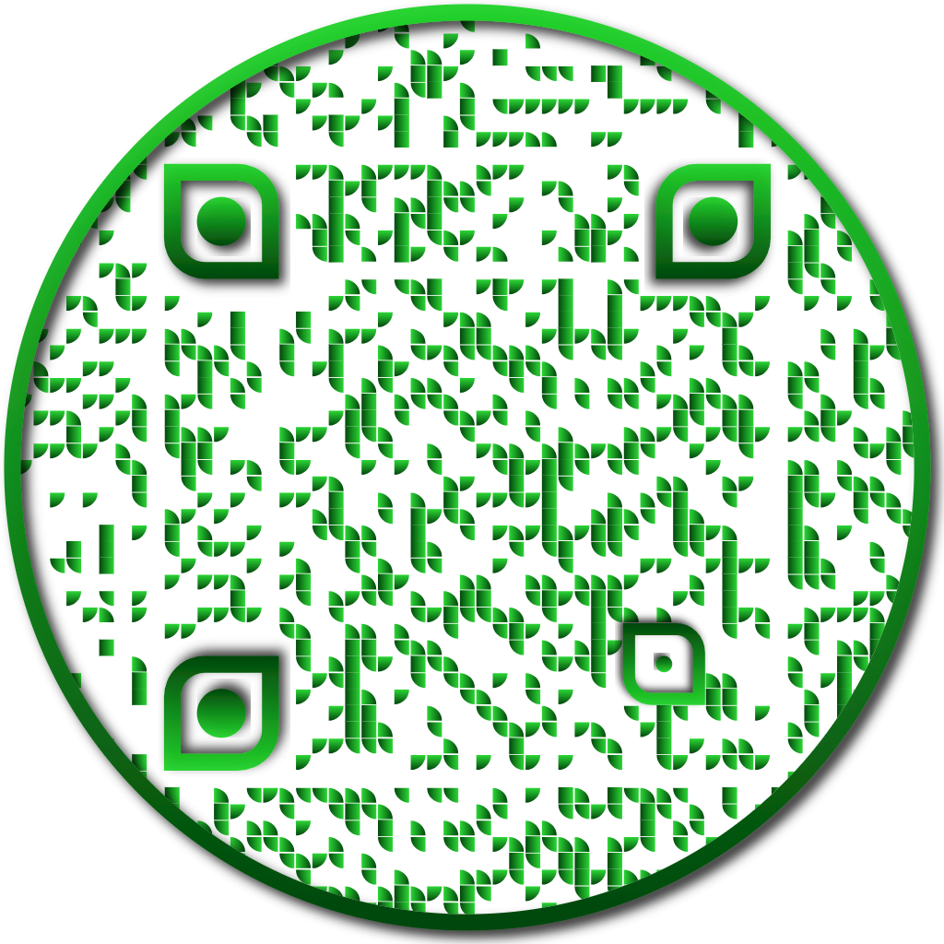

Biostimulant Certification Program
A voluntary, evidence-based program that awards companies a label indicating that their product meets industry-recognized standards for efficacy testing methods, composition, and safety.

Slide 3
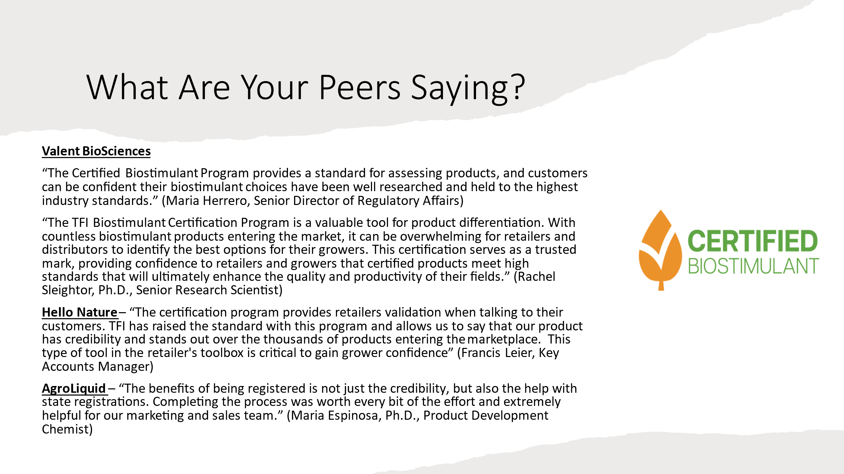

Slide 4
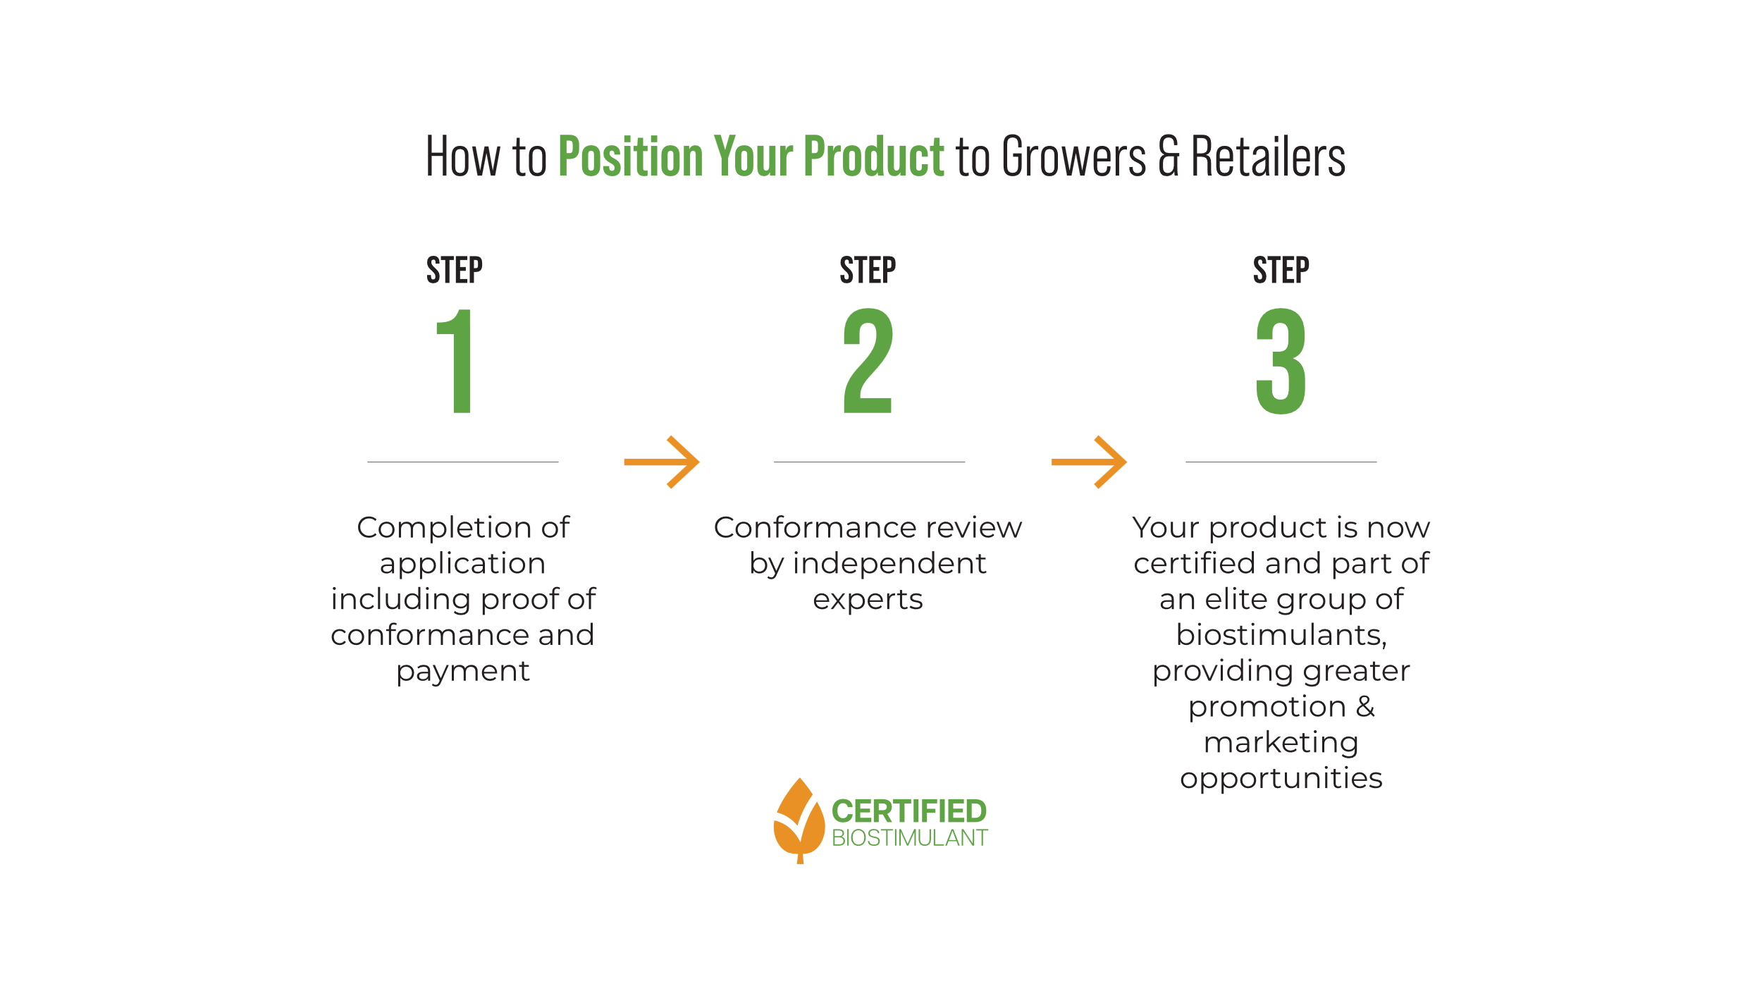
Notes:
Optional: Pre-application consultation
Completion of application including proof of conformance and payment
Conformance review by independent experts
Application review may include additional questions or a virtual call to provide additional information. Application review may take up to 60 business days.
Certification Award

Slide 5
Application
The application consists of an online questionnaire with prompts to upload your supporting documents. There are 5 parts:
  General Information
  Efficacy Testing Methods
  Composition
  Safety
  Confidential Statement and Attestation

Slide 6
Prepared Documents
The online application will ensure you have included all necessary elements and documents for a complete application. There are several documents that will need to be uploaded throughout the online application. Please have these documents prepared prior to starting the application.
Efficacy Testing Methods
  Peer-reviewed literature:
    Published Research Table - Attachment 2
    Peer-reviewed literature (Published literature should demonstrate trials are randomized and replicated, have appropriate controls, and proper statistical analysis according to the U.S. Standard. Missing information in the published literature will require additional information to be submitted.)
  Original/internal research:
    Written Research Report - Attachment 3
Composition
  Beneficial Substances Label - Attachment 4 & Attachment 6
  Conformance Testing Report - Attachment 5
  Methods for identification of the guaranteed substance (must be a recognized method)
Safety
  Safety Data Sheet
  Statement for the Presumption of Safety - Attachment 7 & Attachment 8

Slide 7
Application Best Practices
Does your label claim match what you tested in your efficacy report? Be specific!
Did you put your label in the new AAPFCO format?
Did you provide 2 datasets for each claim?
Did you explain your crop groups?
Did you explain the variability of your dataset with descriptive statistics?
If using NUE, did you explain how you are defining NUE and conduct your statistical analysis on NUE?
Is 50% of your data from the US (for yield and quality claims)?
Did you test for heavy metals, e.coli, and salmonella?
If your product contains plant nutrients, did you use a positive control with the plant nutrient?
Did you explain your high p-value or other statistical anomalies?

Slide 8
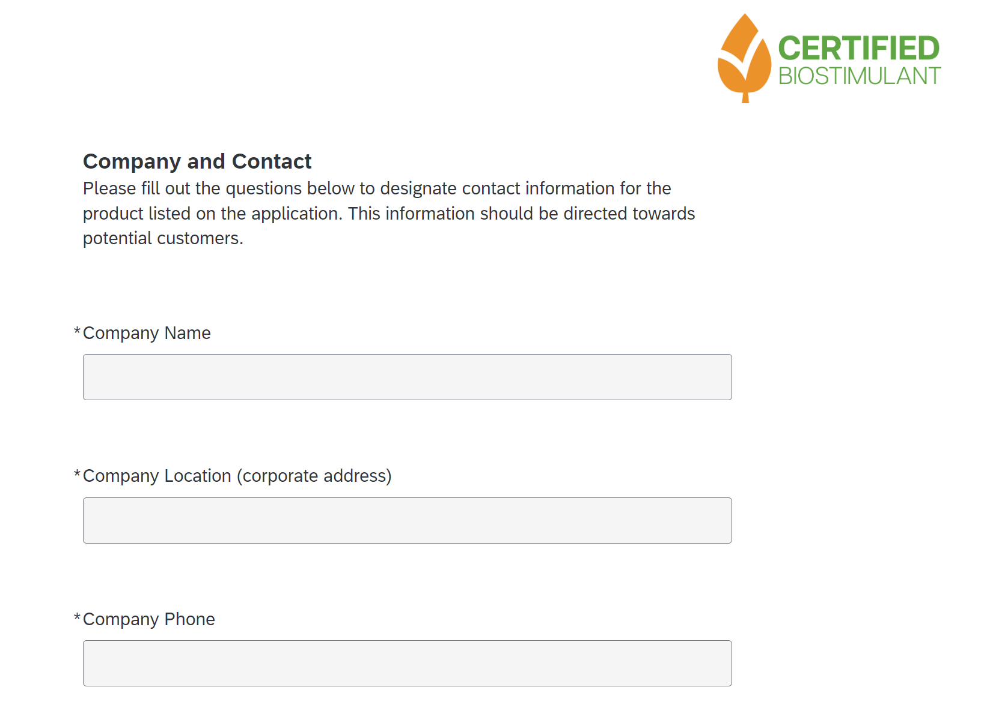

Slide 9
Resources & Tools Available
United States Biostimulant Industry Recommended Guidelines to Support Efficacy, Composition, and Safety of Plant Biostimulant Products
Published Research Table
Guidelines for Written Research Report
Example of the Beneficial Substances Label
Sample Conformance Testing Report
Example Guidelines to support product composition
Safety Assessment Decision Tree
Sample Statement of Rationale for the Presumption of Safety
Copy of Online Application Questionnaire
Application Best Practices
FAQ

Slide 10
Contact Us
Alice McKinnon
amckinnon@tfi.org
Senior Director of Member Programs

